Slide 1
Case 2: KM Dr. J. Miller
71 year old male
Diagnosis: Mixed adenocarcinoma and neuroendocrine neoplasm of the upper lobe of lung (T1b N0 M0); VATS UL wedge resection w/ mediastinal LN dissection in 11/2024
Other Clinical Information:
Performance Status: Not available in EPIC
Hepatic Function: No recent labs in EPIC
Renal Function: BUN 21; Cr. 0.96 (11/2024)
Family History: No relevant family history
Comorbidities: 25 pk yr smoking hx (quit 16 yrs ago)
Planned Therapy:
Planned CT of the thorax for continued oncologic surveillance in 3/2025
Molecular Testing:
Specimen Site: Upper lobe, lung; Collected: 11/2024; Panel: Caris; Dated: 12/2024

Slide 2
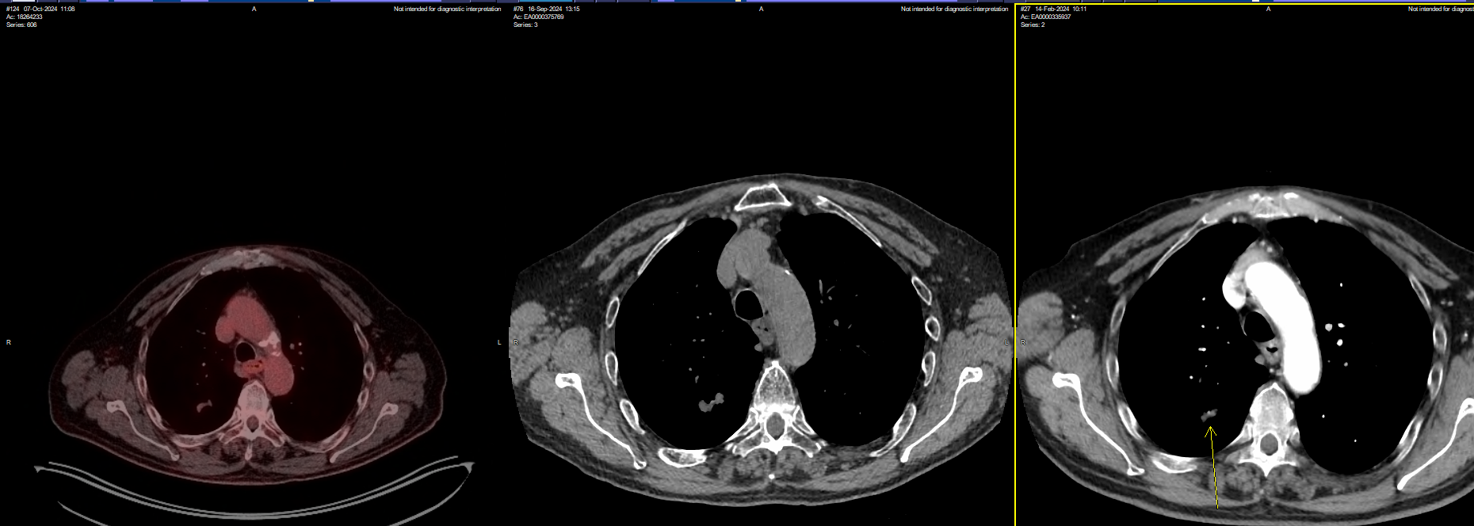
Case 2

Slide 3
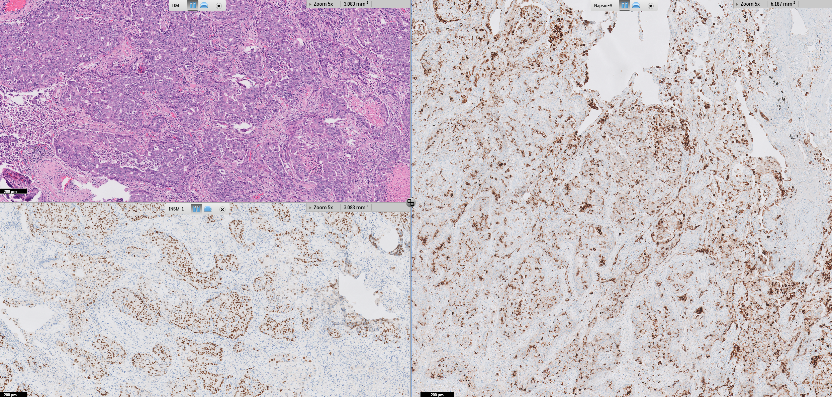
Case 2
MIXED ADENOCARCINOMA AND NEUROENDOCRINE NEOPLASM
Molecular signature is that of an adenocarcinoma: KRAS, STK11, MET fusion; CDKN2A often seen in high-grade adenocarcinomas but enriched for NE transformation under selective pressure from targeting EGFR or ALK (not this patient); there are also reports that ARID1A and MET fusion could also contribute to tumor plasticity and NE lineage switching

Slide 4
Case 2 Prior: None Caris Current: None Dx: Mixed Adenocarcinoma/Neuroendocrine Neoplasm of the Lung
Alteration | Function | Oncogenic? | On-label | Clinical Trial | Off-label (Evidence category) | Allele Frequency (%)
KRAS G12C | Upstream regulator of the MAPK pathway | Yes, gain | None | NCT06208124 (Ph1/2a) NCT05585320 (Ph1/2a) | Adagrasib (3), Sotorasib (3) | 43
SND1-MET fusion | Receptor tyrosine kinase; PI3K/MEK pathways | Likely, gain | None | None | None | N/A
ARID1A Y1260fs | Tumor suppressor; transcriptional regulation | Yes, gain | None | NCT04983745 (Ph 2) NCT05038839 (Ph 1) NCT05687136 (Ph 1b) | None | 9
CDKN2A V28_E33del CDKN2A V126D | CDK4/6 binding; Cell cycle progression | Likely, loss Yes, loss | None | None | None | 23 12
STK11 P179L | Tumor suppressor; intracellular kinase | Likely, loss | None | NCT05887492 (Ph1/2) | None | 23
Notes:
NCT06208124 (Ph1/2a) – IMM-6-415 (MEK inhibitor) – none local
NCT05585320 (Ph1/2a) – IMM-1-104 (MEK1/2 inhibitor) SCRI (after progression on G12C therapy)
Data with tepotinib and crizotinib in some MET fusions but none specifically with SND1-MET (unknown if it is pathologic)
NCT04983745 (Ph 2): niraparib + dostarlimab, solid tumors w/ SOMATIC HRD mutations, only in Germantown, TN
NCT05038839 (Ph 1): cabozantinib + pamiparib (PALB1/2i), solid tumors w/ HRD mutations, only in MDACC
NCT05687136 (Ph 1b): peposertib (DNA-PK inhibitor) + tuvusertib (ATRi), ATM mutations, amplification of MYC, mutation of FBXW7, CCNE1 amplification, SWI/SNF member mutation (ARID1A, PBRM1, SMARCA4, ARID2, ARID1b, SMARCA2, SS18), and ATRX/DAXX, only at NCI or Boston
NCT05887492 – TNG260 (CoRESTi + pembro) SCRI – designed to overcome IO resistance with STK11 mutations [Co-repressor of Repressor Element-1 Silencing Transcription]

Slide 5
Case 2 Prior: None Caris Current: None Dx: Mixed Adenocarcinoma/Neuroendocrine Neoplasm of the Lung
Alteration | Function | Oncogenic? | On-label | Clinical Trial | Off-label (Evidence category) | Allele Frequency (%)
TMB | Measures mutation/Mb DNA | 8, low | None | None | None | N/A
MSI | Measures hypermutability | Stable | None | None | None | N/A
PD-L1 | Measures response to immunotherapy | 1% (TPS) 1+, 5% (28-8) | None | None | Immunotherapy (3) | N/A

